Slide 1
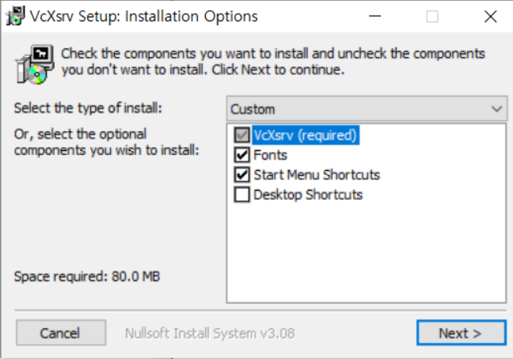
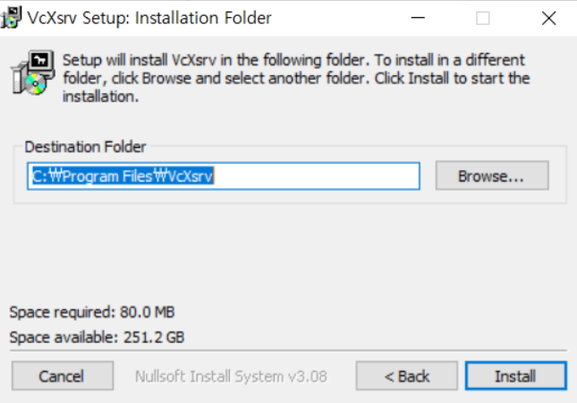

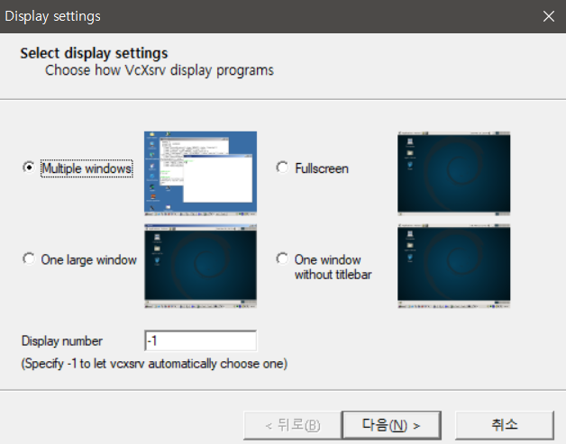
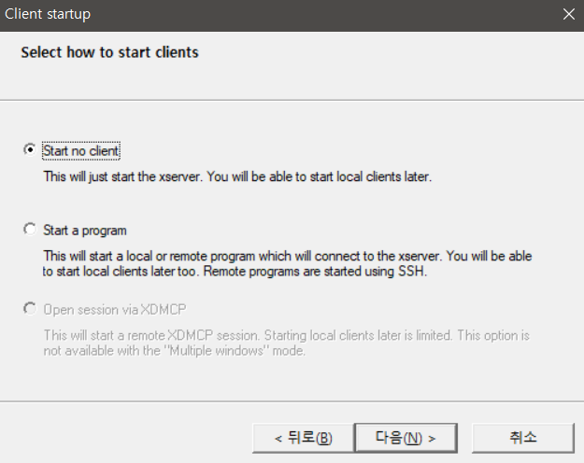
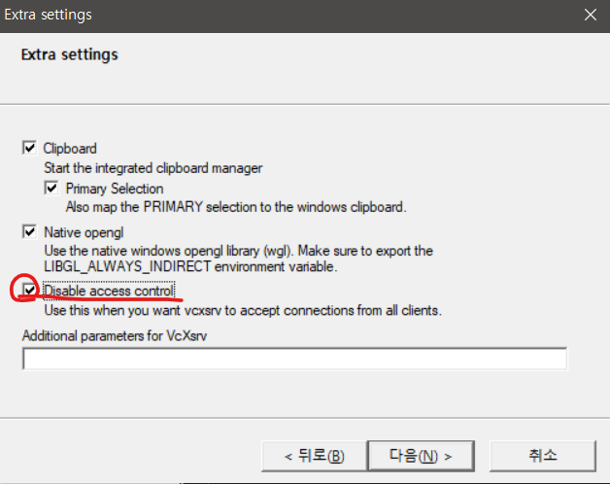
* CMD or Powershell 관리자 권한 실행
dism.exe /online /enable-feature /featurename:Microsoft-Windows-Subsystem-Linux /all /norestart
dism.exe /online /enable-feature /featurename:VirtualMachinePlatform /all /norestart
wsl --set-default-version 2
다운로드 후 설치
https://wslstorestorage.blob.core.windows.net/wslblob/wsl_update_x64.msi
다운로드 후 설치
https://sourceforge.net/projects/vcxsrv/
Xlaunch 실행
Microsoft store ubutntu 20.04(WSL) 설치
https://apps.microsoft.com/detail/9mttcl66cpxj?hl=en-us&gl=US
In Ubuntu 20.04
git clone -n --depth=1 --filter=tree:0 https://github.com/seonghoonko/plotjuggler.git && cd ~/plotjuggler && git sparse-checkout set --no-cone installer && git checkout && cd ~/plotjuggler/installer && chmod +x 1_installer.sh ; chmod +x 2_installer.sh ; ./1_installer.sh ; ./2_installer.sh ;
실행 op_plot

Slide 2

Appendix
1_Install_plot.sh 내용
#!/usr/bin/bash
cd ~;
sudo apt update ;
upgrade ;
sudo apt install x11-apps -y ;
sudo apt install python3-pip ;
curl https://bootstrap.pypa.io/get\-pip.py \-o get\-pip.py ;
python3 get-pip.py ; pip3 install pip --upgrade ;
sudo pip install --ignore-installed poetry ;
sudo apt install python3-testresources ;
poetry init –n ; pip3 install numpy ;
sudo apt install scons ;
pip3 install scons ;
curl -s https://packagecloud.io/install/repositories/github/git-lfs/script.deb.sh | sudo bash ;
sudo apt-get update ;
sudo apt install git-lfs;
cd ~ ;
git clone --recurse-submodules https://github.com/commaai/openpilot.git ;
cd ~/openpilot ; git lfs pull ;
export PYTHONPATH="/home/$USER/openpilot/.venv/bin/python3:/home/$USER
/openpilot";
export DISPLAY="`grep nameserver /etc/resolv.conf | sed 's/nameserver //'`:0";
export LIBGL_ALWAYS_INDIRECT=1;
export DISPLAY=$WSL_IF_IP:0;
unset LIBGL_ALWAYS_INDIRECT;
cd ~/openpilot&&tools/ubuntu_setup.sh ;
cd ~/openpilot&&poetry shell ;
#add .bashrc for qt (network connection)
cd ~;
sed '98 i\
#Custom alias
alias op_plot='cd ~/openpilot/tools/plotjuggler&&./juggle.py --stream’' .bashrc;
sed '$s/$/\n
export PYTHONPATH="/home/$USER/openpilot/.venv/bin/python3:/home/$USER
/openpilot"
export DISPLAY="`grep nameserver /etc/resolv.conf | sed 's/nameserver //'`:0"
export LIBGL_ALWAYS_INDIRECT=1
export DISPLAY=$WSL_IF_IP:0
unset LIBGL_ALWAYS_INDIRECT
/g' .bashrc;
2_Install_plot.sh 내용
#!/usr/bin/bash
# build openpilot & install plotjuggler
cd ~/openpilot && scons -u -j$(nproc) ;
cd ~/openpilot/tools/plotjuggler ;
./juggle.py --install
*우분투 설치 위치
\\wsl$\
+ R 실행
*WSL 설치 안될때 CMD 나 Powershell 로 설치
wsl --unregister ubuntu
wsl –unregister ubuntu-20.04
wsl --install -d Ubuntu-20.04

Slide 3
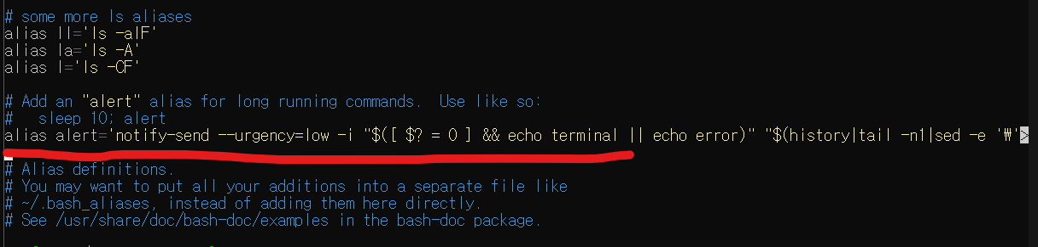
Appendix
우분투 사용자 이름 및 비밀번호 설정 후
sudo nano ~/.bashrc
빨간줄 친 부분에 아래 내용을 추가
#Custom alias
alias op_pl='cd ~/openpilot/tools/plotjuggler&&./juggle.py --stream’
맨 끝줄에,
export PYTHONPATH="/home/$USER/openpilot/.venv/bin/python3:/home/$USER
/openpilot"
export DISPLAY="`grep nameserver /etc/resolv.conf | sed 's/nameserver //'`:0"
export LIBGL_ALWAYS_INDIRECT=1
export DISPLAY=$WSL_IF_IP:0
unset LIBGL_ALWAYS_INDIRECT
cd ~/openpilot&&poetry shell ;
내용 추가 후
Ctrl + X & Y & Enter

